Slide 1
Query Processing and Optimization
Dr. S. RENUKA DEVI
Associate Professor
SCSE
VIT Chennai Campus

Slide 2
Introduction to Query Processing
Two internal representations of a query:
Query Tree
Query Graph
Query optimization:
The process of choosing a suitable execution strategy for processing a query.

Slide 3
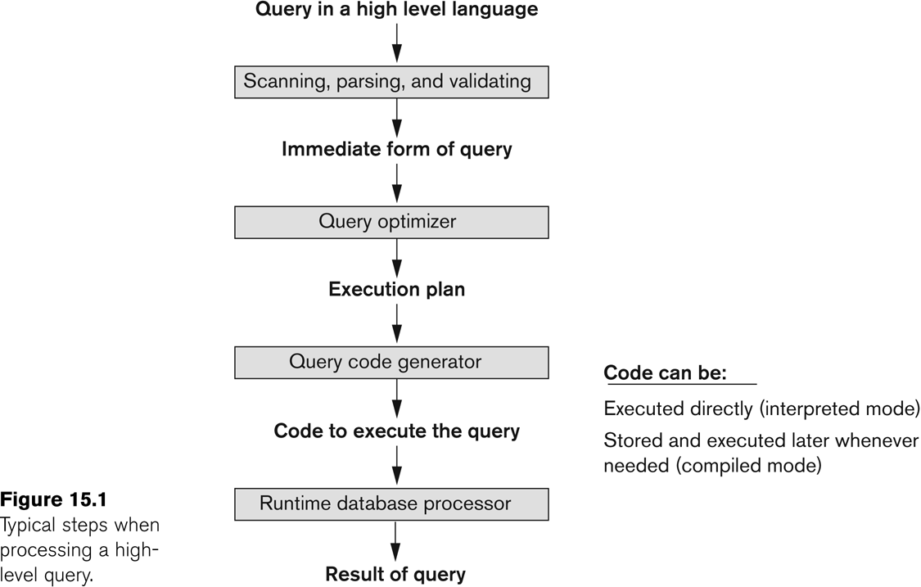
Introduction to Query Processing (contd…)

Slide 4
Query Optimization
There are two main techniques that are employed during query optimization
First technique is based on heuristic rules for ordering the operations in a query execution strategy
A heuristic is a rule that works well in most cases but is not guaranteed to work well in every case
Second technique involves systematically estimating the cost of different execution strategies and choosing the execution plan with the lowest cost estimate.
These techniques are usually combined in a query optimizer.

Slide 5
Translating SQL Queries into Relational Algebra
Query block:
The basic unit that can be translated into the algebraic operators and optimized.
A query block contains a single SELECT-FROM-WHERE expression, as well as GROUP BY and HAVING clause if these are part of the block.
Nested queries within a query are identified as separate query blocks.
Aggregate operators in SQL must be included in the extended algebra.

Slide 6
Translating SQL Queries into Relational Algebra
SELECT LNAME, FNAME
FROM EMPLOYEE
WHERE SALARY > ( SELECT MAX (SALARY)
FROM EMPLOYEE
WHERE DNO = 5);
SELECT LNAME, FNAME
FROM EMPLOYEE
WHERE SALARY > C
SELECT MAX (SALARY)
FROM EMPLOYEE
WHERE DNO = 5
π_{LNAME, FNAME} (σ_{SALARY>C}(EMPLOYEE))
ℱ_{MAX SALARY} (σ_{DNO=5} (EMPLOYEE))

Slide 7
Using Heuristics in Query Optimization (1)
Process for heuristics optimization
The parser of a high-level query generates an initial internal representation;
Apply heuristics rules to optimize the internal representation.
A query execution plan is generated to execute groups of operations based on the access paths available on the files involved in the query.
The main heuristic is to apply first the operations that reduce the size of intermediate results.
E.g., Apply SELECT and PROJECT operations before applying the JOIN or other binary operations.

Slide 8
Using Heuristics in Query Optimization (2)
Query tree:
A tree data structure that is used to represent a relational algebra expression.
It represents the input relations of the query as leaf nodes of the tree, and represents the relational algebra operations as internal nodes.
An execution of the query tree consists of executing an internal node operation whenever its operands are available and then replacing that internal node by the relation that results from executing the operation.
The order of execution of operations starts at the leaf nodes and ends at the root node.
The execution terminates when the root node operation is executed and produces the result relation for the query.

Slide 9
Using Heuristics in Query Optimization (3)
Example:
For every project located in ‘Stafford’, retrieve the project number, the controlling department number and the department manager’s last name, address and birthdate.
Relation algebra:
πPNUMBER, DNUM, LNAME, ADDRESS, BDATE (((σ_{PLOCATION=‘STAFFORD’}(PROJECT))*
_{DNUM=DNUMBER} (DEPARTMENT)) * _{MGRSSN=SSN} (EMPLOYEE))
SQL query:
Q2: SELECT P.NUMBER,P.DNUM,E.LNAME, E.ADDRESS, E.BDATE
FROM PROJECT AS P, DEPARTMENT AS D, EMPLOYEE AS E
WHERE P.DNUM=D.DNUMBER AND D.MGRSSN=E.SSN AND P.PLOCATION=‘STAFFORD’;

Slide 10
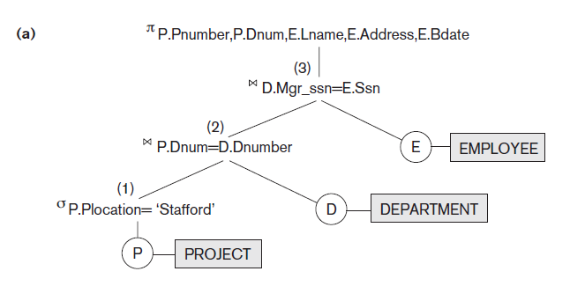
Using Heuristics in Query Optimization (4)
Query tree corresponding to the relational algebric expression for Q2

Slide 11
Using Heuristics in Query Optimization (5)
Heuristic Optimization of Query Trees:
The same query could correspond to many different relational algebra expressions — and hence many different query trees.
The task of heuristic optimization of query trees is to find a final query tree that is efficient to execute.
Example:
Q: SELECT LNAME
FROM EMPLOYEE, WORKS_ON, PROJECT
WHERE PNAME = ‘AQUARIUS’ AND PNMUBER=PNO AND ESSN=SSN AND BDATE > ‘1957-12-31’;

Slide 12
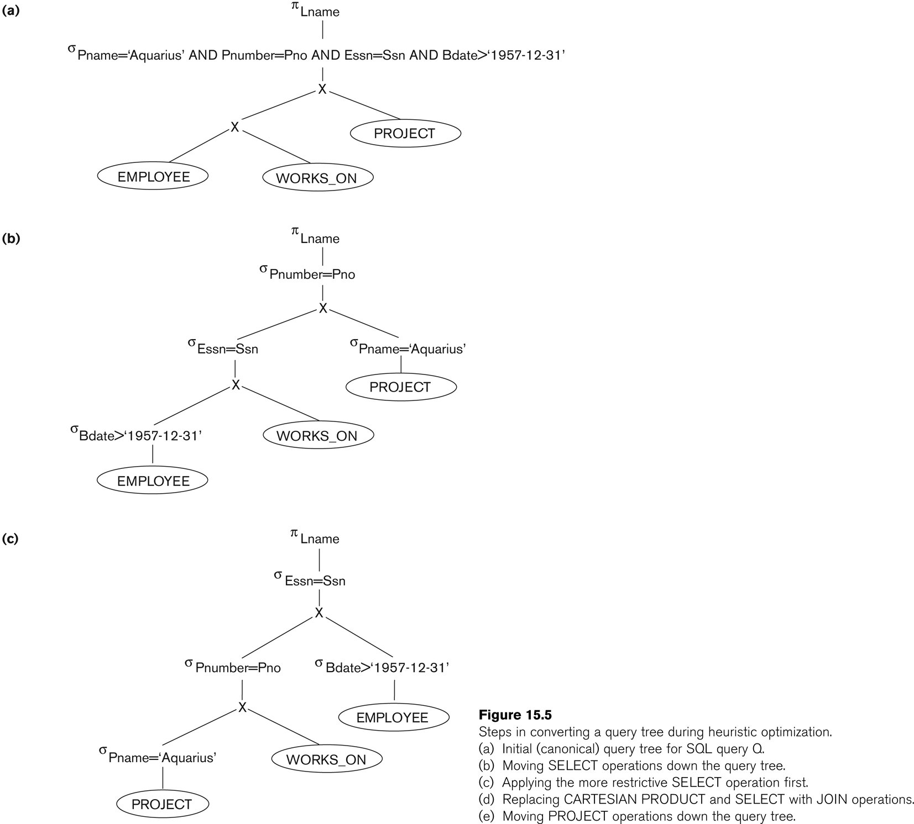
Using Heuristics in Query Optimization (6)

Slide 13
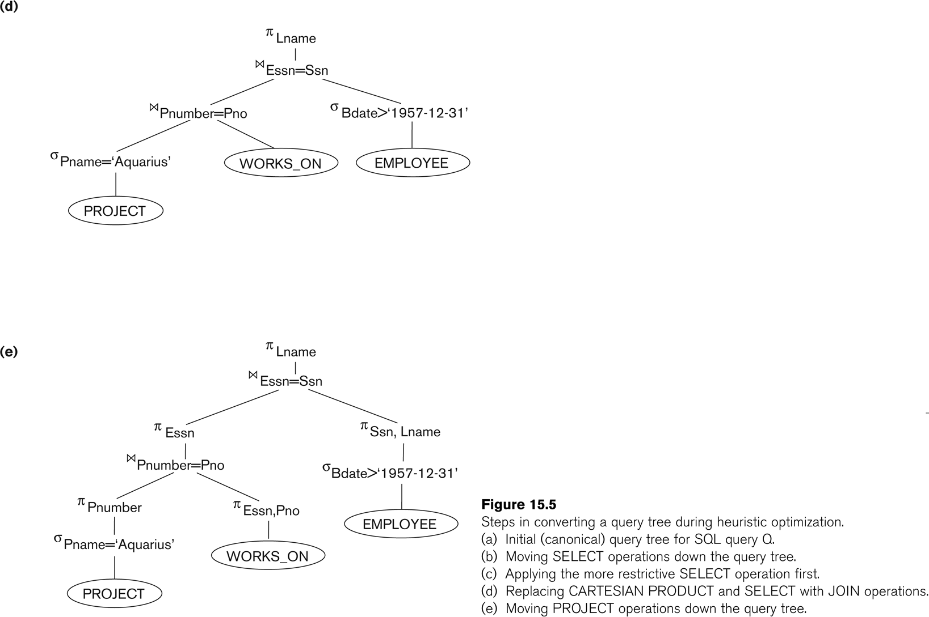
Using Heuristics in Query Optimization (7)

Slide 14
Using Heuristics in Query Optimization (8)
Summary of Heuristics for Algebraic Optimization:
The main heuristic is to apply first the operations that reduce the size of intermediate results
Perform select operations as early as possible to reduce the number of tuples and perform project operations as early as possible to reduce the number of attributes
The select and join operations that are most restrictive should be executed before other similar operations.

Slide 15
Any Queries?

